Slide 1


German Traffic Sign Classification
Introduction to image recognition and Convolutional Neural Networks

Slide 2
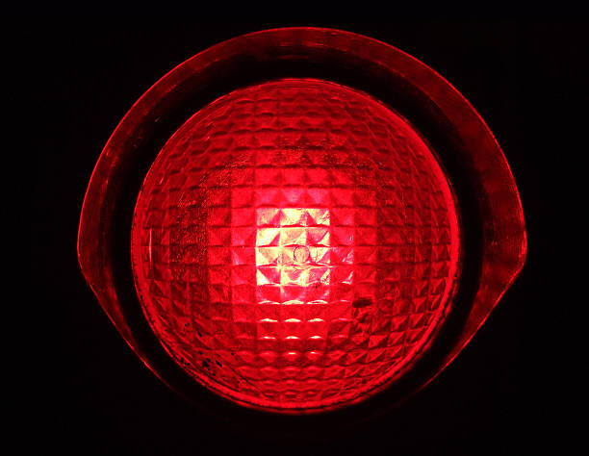
Goals for the Presentation
 | Mandatory | Optional
Data Preparation | Provide and overall description of the Dataset | Describe how the features and records are distributed
Data Analysis | Apply one analysis technique and discuss the evaluation parameters found | Apply two or more analysis techniques and compare results.
Data Visualization |  | Use visualization techniques to show results.

Slide 3
Recognizing Traffic Signs: The goal is to build a model capable of determining the type of traffic sign that is displayed in an image captured under different real-life conditions.

Slide 4
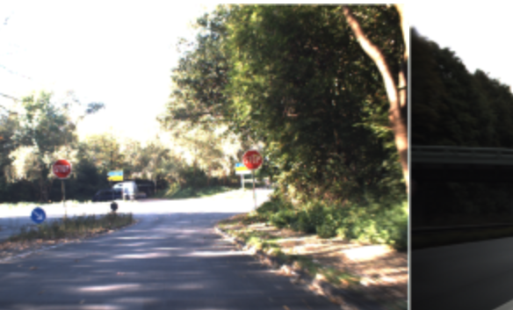
Why do this?
Autonomous driving cars
https://benchmark.ini.rub.de/gtsdb_news.html

Slide 5
Data
Training set – 34799
Validation set –12630
Test set – 4410
Sign Names – 43
Image Shape – 32, 32, 3
(width, height, depth/color channels)

Slide 6
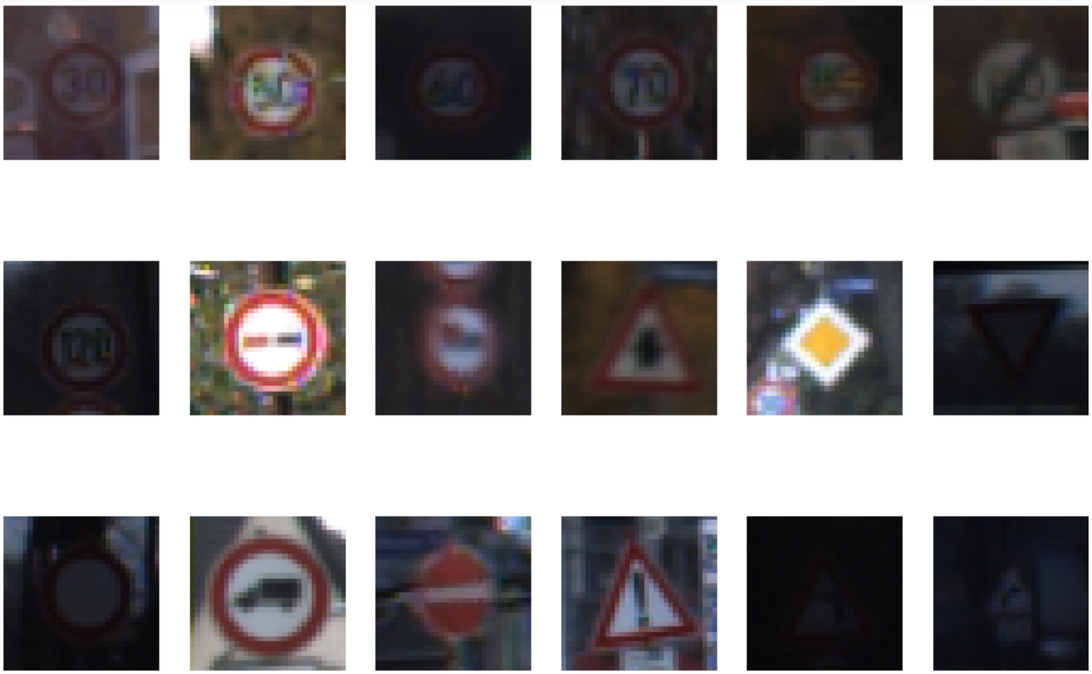
Sign Images

Slide 7
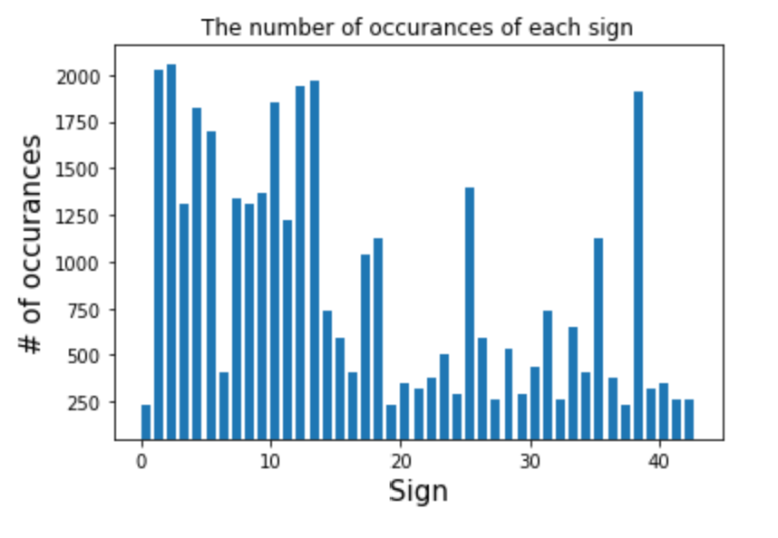
Distribution

Slide 8
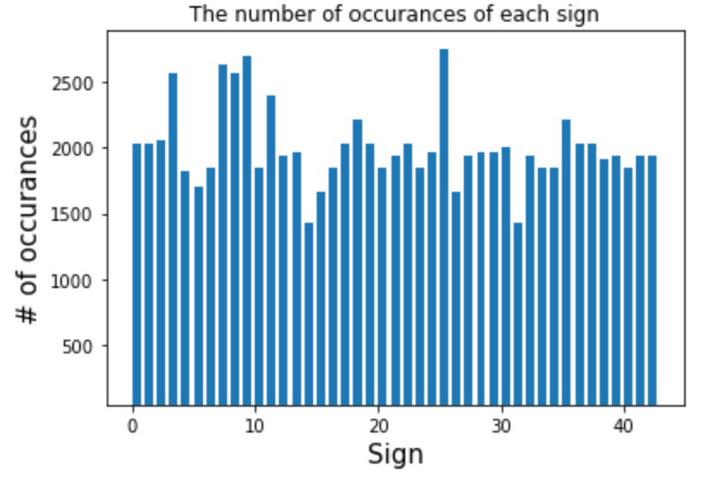
Distribution Equalized

Slide 9

Image Augmentation

Slide 10
Accuracy Improvement?
Distribution Equalization – no change
Image Normalization – decreased accuracy
Other Image augmentation
Black and white – no change
Increase brightness – decreased accuracy

Slide 11
Convolutional Neural Network
Convolutional | Pooling | Fully-Connected

Slide 12
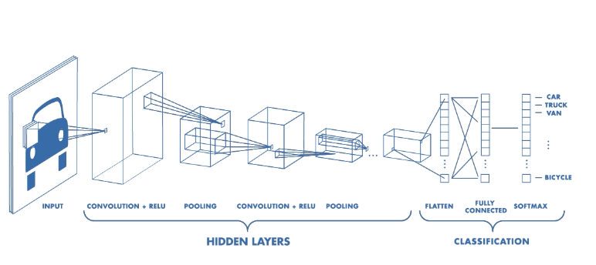
Convolutional Neural Network
https://medium.com/@sdoshi579/convolutional-neural-network-learn-and-apply-3dac9acfe2b6

Slide 13
Convolutional Layer
https://medium.com/@sdoshi579/convolutional-neural-network-learn-and-apply-3dac9acfe2b6

Slide 14
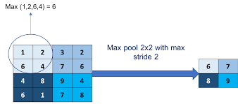
Pooling Layer (max or average)
https://medium.com/@sdoshi579/convolutional-neural-network-learn-and-apply-3dac9acfe2b6

Slide 15
Fully-Connected Layer
Connects the previous layers to ouput
Softmax Activation
Output is 43 probabilities

Slide 16
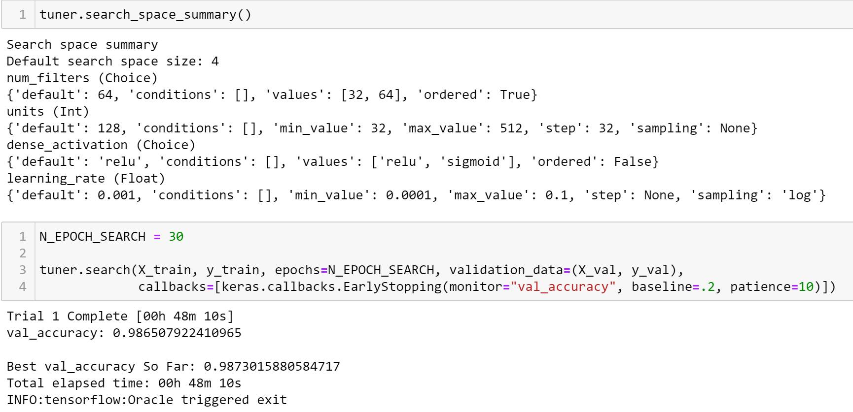
Model Tuning

Slide 17
Future Tuning
More layers
Better image augmentation, especially black and white
More hyperparameters
Larger hyperparameter range

Slide 18
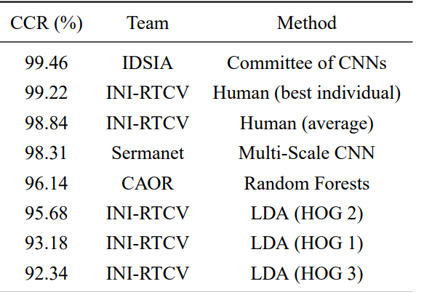


Potential?
https://christian-igel.github.io/paper/MvCBMLAfTSR.pdf

Slide 19
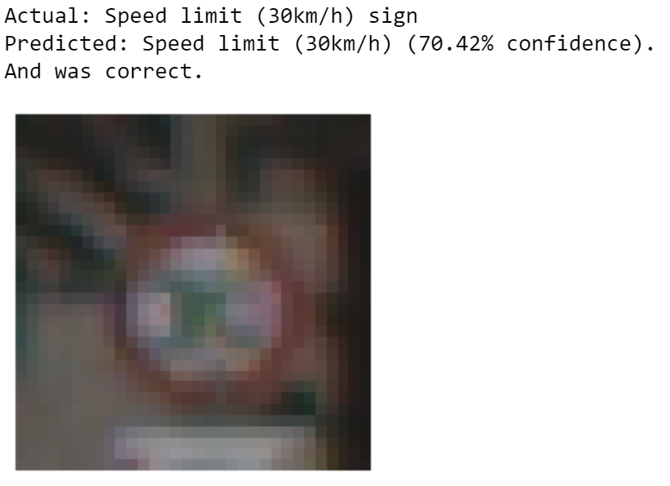
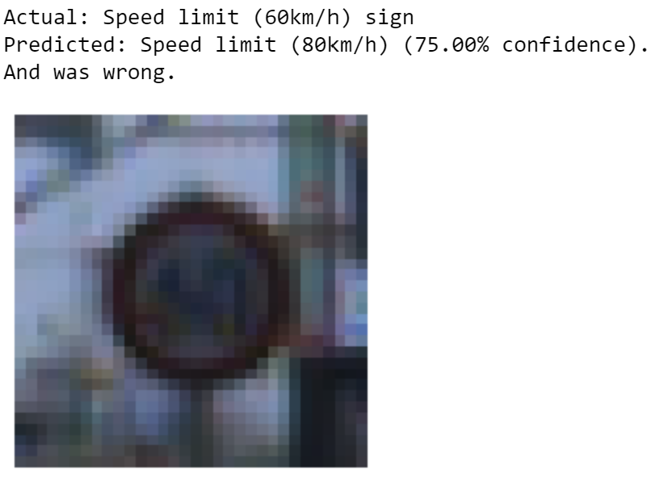
Final Results
Validation | Test
98.73% | 97.04%

Slide 20





Conclusion
 | Mandatory | Optional
Data Preparation | Provide and overall description of the Dataset | Describe how the features and records are distributed
Data Analysis | Apply one analysis technique and discuss the evaluation parameters found | Apply two or more analysis techniques and compare results.
Data Visualization |  | Use visualization techniques to show results.

